Slide 1
Data Reduction ESS
Mantid User Meeting April 2019
Thomas Holm Rod / Owen Arnold

Slide 2
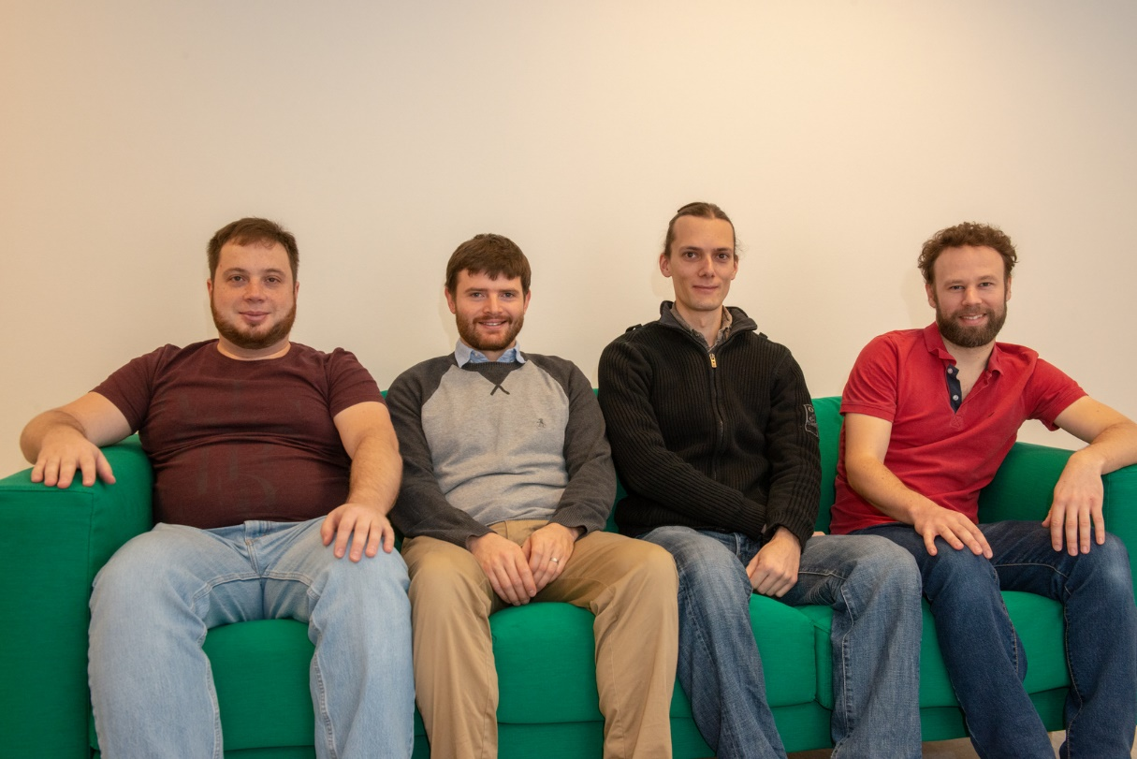
Welcoming New Team Members
Neil Vaytet
Igor Gudich
Notes:
Owen’s slides

Slide 3
Nexus Geometry Format
As of September 2018 Nexus Format supports complete geometry descriptions in datafiles
Mantid first external application capable of reading new format
Loading significantly faster over IDFs in many cases
Arrives with Mantid 4.0
Notes:
Neil + Owen + ECDC
Built through close collaboration with DMSC Data Streaming group.
Image shows Utah tea-pot which was used as a monitor geometry for demo purposes.

Slide 4
V20 Beamline Support
Significant support for testing operations
Complex chopper cascades + stitching
Processing real ESS format files (Nexus Geometry)
Notes:
Sample? Silicon

Slide 5
Instrument Visualisation
Major performance work on Instrument Visualisation. Now uses Instrument 2.0.
Support for ESS volumetric visualisation
Instrument | Speed-up
WISH | 5x
BASIS | 5x
GEM | 4x
SANS2D | 3x
POLARIS | 3x
CNCS | 2x
Notes:
Table shows load times in instrument view for various instruments after refactoring to use new Instrument 2.0 layers. Results compare mantid version 3.13 to v 3.12.
Volumetric visualization key for ESS instrument such as CSPEC and DREAM.

Slide 6
Core Team - Dataset
Borne out of future of workspaces project
Promising prototype now undergoing further development into minimal viable product
Notes:
Major strengths of design:
No workspace subtypes. Very high degree of flexibility of how data structures work. Follows duck typing mantra: "If it walks like a duck and it quacks like a duck, then it must be a duck”
Precision is controllable, float or double
Automatic handing of variables and variance
Good support for units and dimensions along with correct semantics of operations.
Design delay the onset of MPI for certain problem types.
This design is some distance off being “usable” and many hurdles to deal with yet. Will not be completed and finalised in Mantid 4.1.
Design has traction in other scientific operations within the DMSC centre.

Slide 7
Immediate Future Plans
Transition to operations end 2019
Collaborative milestones DONKI project
Work on LOKI and on-the-fly reduction
Scalability testing with LOKI
Continued work on Dataset
Continued work on MD space filling curves
V20
Operational support till end-of-lifetime December 2019
WFM and chopper configuration handling

Slide 8
Long-term Plans
Ensure that ESS experimental needs can be met with DR
Ensure that performance needs and scalability is provided for ESS as power and pixilation increase
Ensure that software investments are future proof and suitable for next 10+ years

